Slide 1
UML Collaboration Diagram
V1.0
Noviembre 2011
Ferreiras

Slide 2

UML Collaboration diagrams (interaction diagrams) illustrate the relationship and interaction between software objects. They require the artifacts:
➢ Use cases;
➢ System operation contracts; And
➢ Domain model.
All these artifact are required to exist already.

Slide 3
 The collaboration diagram illustrates messages being sent between classes and objects (instances).
For each system operation contract ⇒ A collaboration diagram is created for each system operation that relates to the current development cycle (iteration).

Slide 4
When creating collaboration diagrams, patterns are used to justify relationships. Patterns are best principles for assigning responsibilities to objects and are described further in the section on patterns. There are three main types of patterns used for assigning responsibilities:
➢ Facade pattern ;
➢ Creator pattern ; And,
➢ Expert pattern.

Slide 5
 Each system operation contract corresponds to a high-level system event.;
 Using the postconditions shown in the contract for each system operation, determine which objects should perform each responsibility.
 Create operations to complete each responsibility and place them in the appropriate class.

Slide 6
 At this time, the concepts in the domain model become classes in the class diagram.
 Add a façade object to act as controller for the system. This façade object is in fact the System concept shown on the System Sequence Diagram.

Slide 7
 This means that the messages from actors to the system in the SSD become the operations of the facade object;
 Make sure that there is a chain of messages linking the facade class to the objects which collaborate with it to carry out the system operation.

Slide 8
Each system operation contract initiates a collaboration diagram. Therefore, there is a collaboration diagram for every system operation contract. An example diagram for purchasing a bus ticket:
I repeat to you

Slide 9
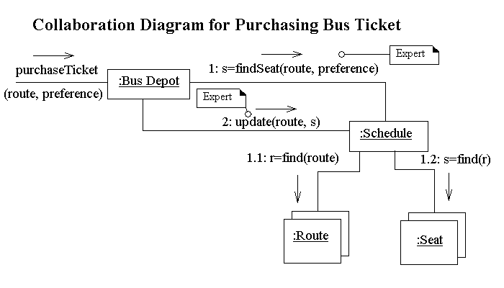

Slide 10
 The route and seat objects are multi objects which means they are a collection of objects.
 The message, purchaseTicket(route, preference) is the initializing message which is generated by the initializing actor.

Slide 11
 All other messages are generated by the system between objects.
 The initializing message is not numbered.
 The first message after the initializing message is numbered.

Slide 12
 Messages that are dependent on previous messages are numbered based on the number of the message they are dependent on.
➢ Therefore the message, "r=findRoute(route)" is numbered "1.1" since it is dependent on the message "s=findSeat(route, preference)".

Slide 13
 Any message path that is mutually exclusive is numbered with an "a" or "b".
➢ In finding route and seat messages, if finding a route or a seat were mutually exclusive, the numbering would be 1.1a and 1.1b.
 Patterns used for the association are associated with the message using a note.

Slide 14
 Creation messages “create(parameter)”
 Iteration - Designated with a message line like: "1* [i:=1..5]: message3()"
➢ Grouped - Although on two separate lines connecting objects both messages use the same variable such as the following two messages:
◆ 1* [i=1..5]: message3()
◆ 2* [i=1..5]: message3()

Slide 15
➢ Separate - Written on two seperate lines connecting objects each message uses a different variable name:
◆ 1* [i=1..5]: message3()
◆ 2* [j=1..5]: message3()

Slide 16
 Messages to self.
 Messages to multiobjects - The message is to the container, not the object in the container. (add, find, remove, next, size, contains)
The diagram should be split if it gets too large.

Slide 17
 Each system operation contract corresponds to a high-level system event.;
 Using the postconditions shown in the contract for each system operation, determine which objects should perform each responsibility.
 Create operations to complete each responsibility and place them in the appropriate class.

Slide 18
 At this time, the concepts in the domain model become classes in the class diagram.
 Add a façade object to act as controller for the system. This façade object is in fact the System concept shown on the System Sequence Diagram.

Slide 19
 This means that the messages from actors to the system in the SSD become the operations of the facade object;
 Make sure that there is a chain of messages linking the facade class to the objects which collaborate with it to carry out the system operation.

Slide 20
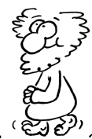
Reference
1 ) http://www.comptechdoc.org/independent/uml/begin/index.html
2 ) http://ferreiras.com.org

Slide 21
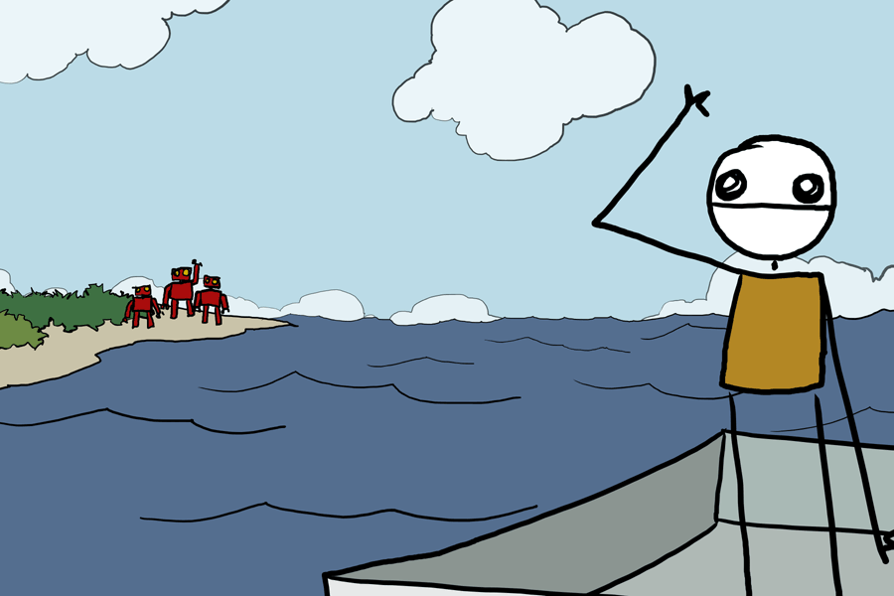
Thanks

